Slide 1

Gasoline Price Prediction
Understanding and Predicting Near-Term Trends in Gasoline Prices
Contributed by Tianchen Wang, Wei Xia, Shih-Yu Huang and Tang-Shuo Kao
Presented by Shih-Yu Huang and Tang-Shuo Kao

Slide 2
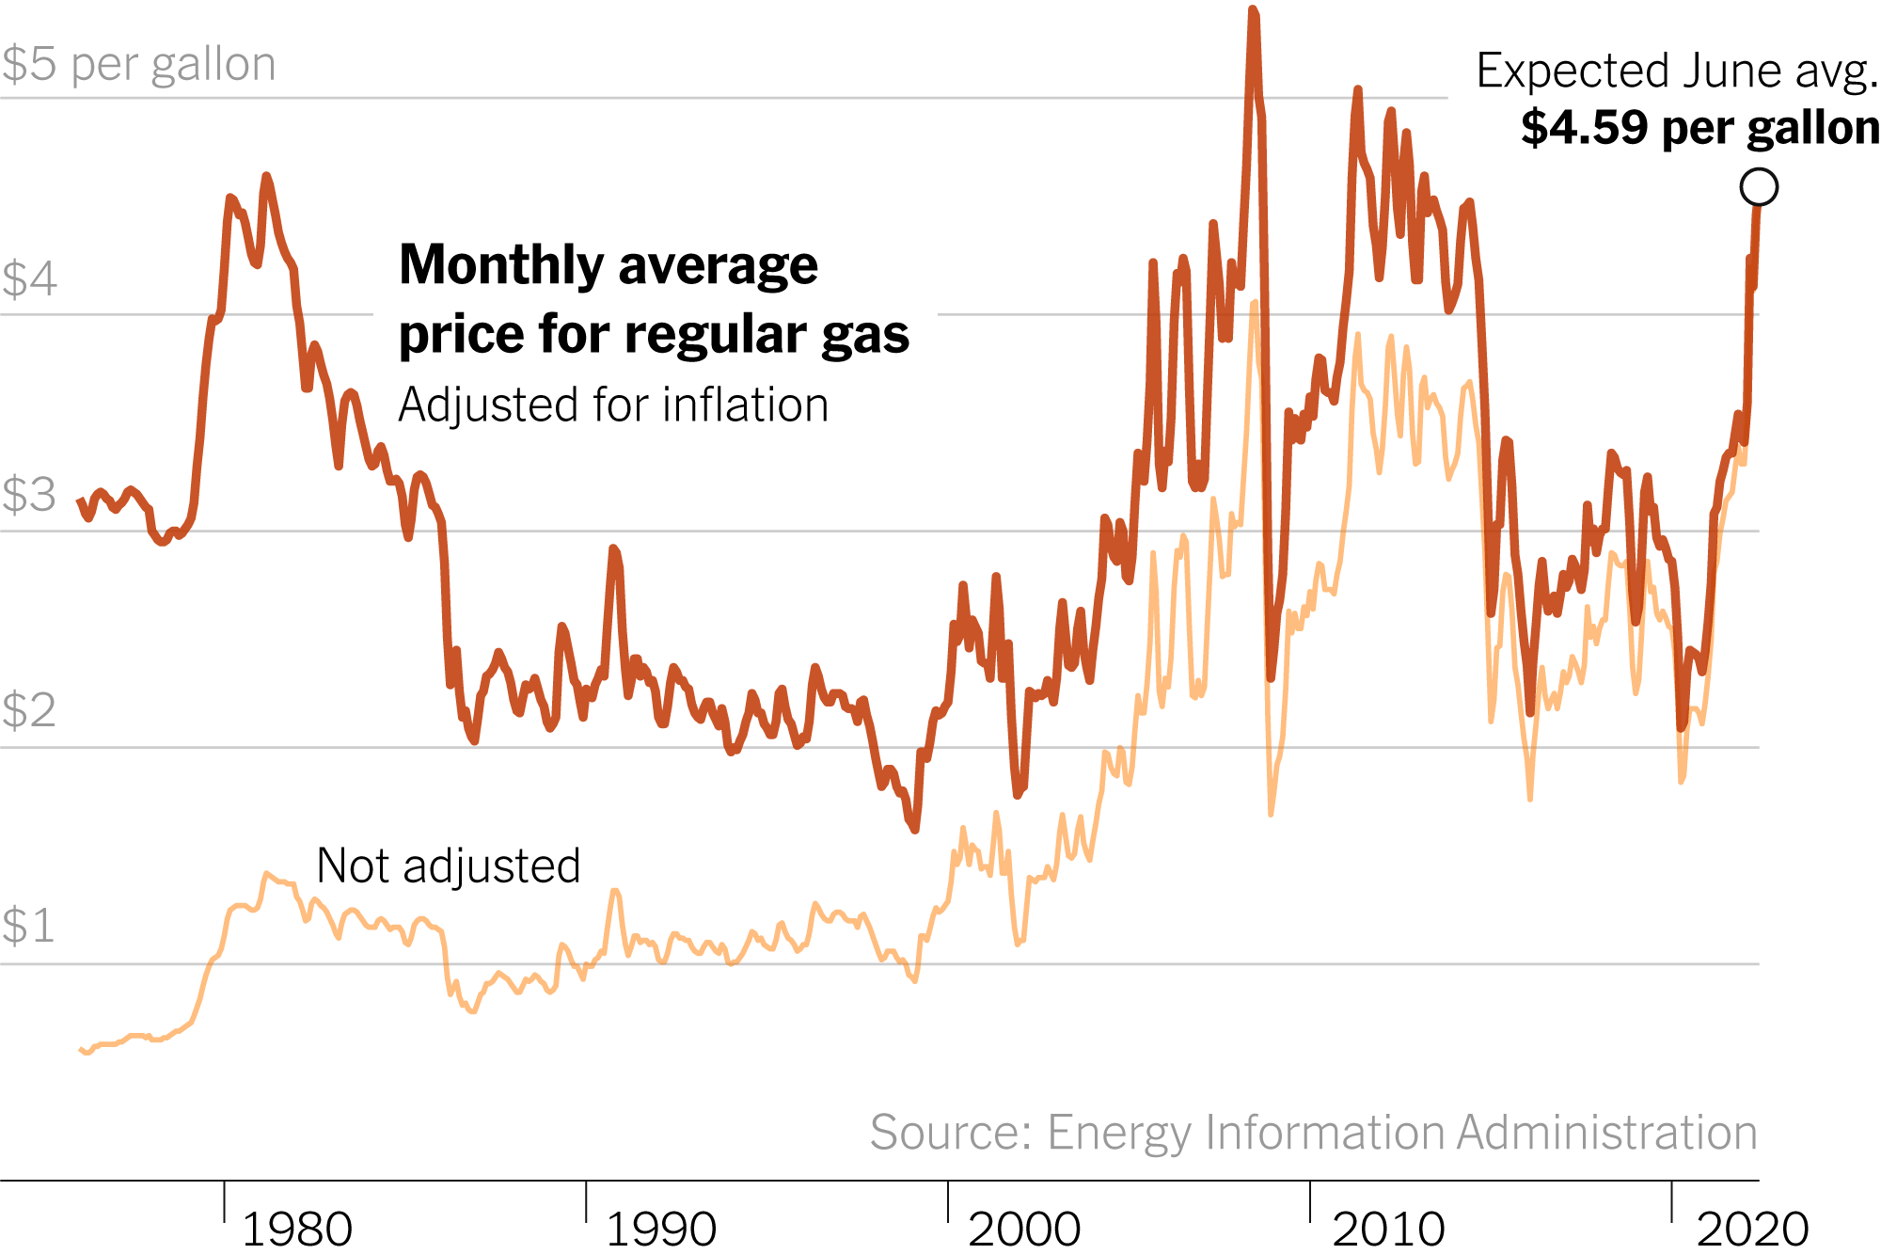
Problem Statement
Rising gasoline prices impact citizens and policymakers. (In fact, everyone cares gasoline prices)
Need for near-term predictions to aid in budgeting and policy formulation.
Key Question:
Can we accurately predict next week's gasoline prices?
Contributed by Wei Xia & Tang-Shuo Kao

Slide 3
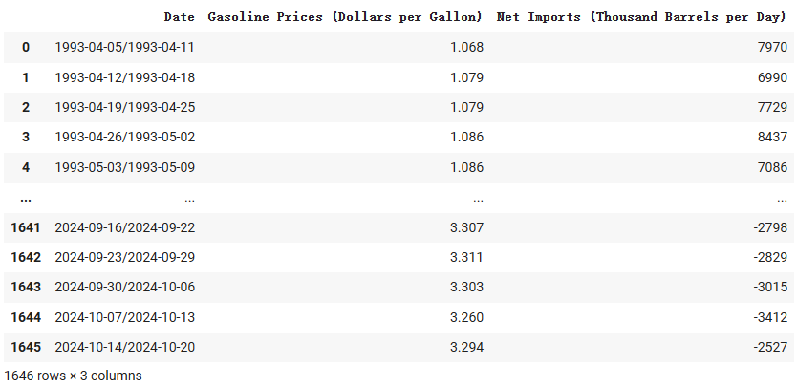
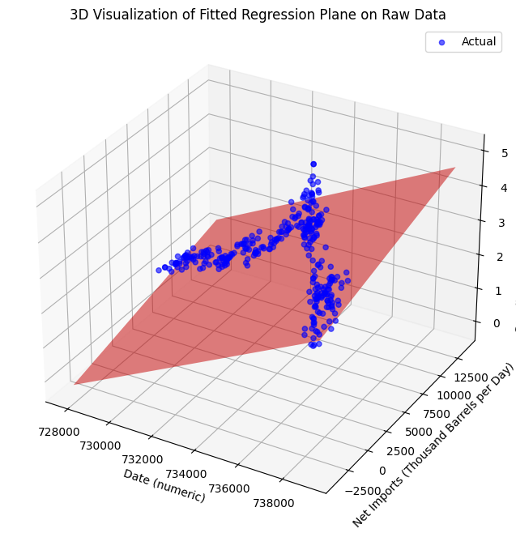
Data Description
• Dataset Overview:
Date & Time.
Weekly U.S. net imports of crude oil and petroleum products
Historical gasoline prices
Additional features (e.g., weather, car sales) not used
• Data Sources:
https://www.eia.gov (gasoline prices & net imports)
https://www.ncdc.noaa.gov/cdo-web/datasets (explored but not used)
Contributed by Wei Xia & Tang-Shuo Kao
Notes:
Please mention the explicit sample data on the right. You could also talk about the shape of our sample data.

Slide 4
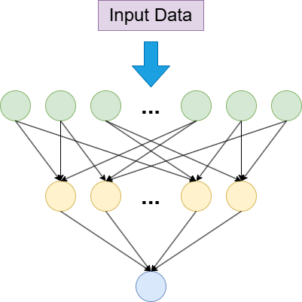
Methodology
• Model: A fully connected feedforward neural network, designed for regression tasks to predict gasoline price changes
• Architecture:
• Input layer to process features
• Multiple dense (fully connected) layers with activation functions like ReLU and Leaky ReLU
• Dropout layers for regularization
• Output layer with a linear activation for price prediction
Model Architecture
Contributed by Tianchen Wang

Slide 5
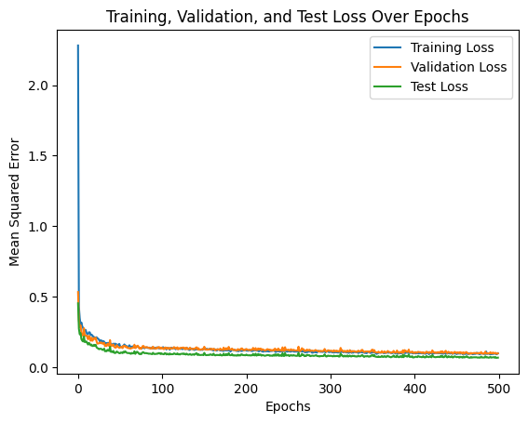
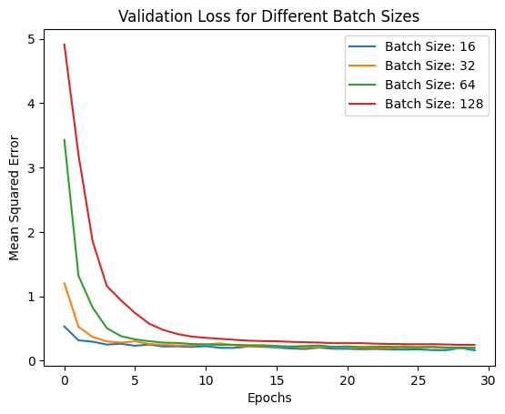
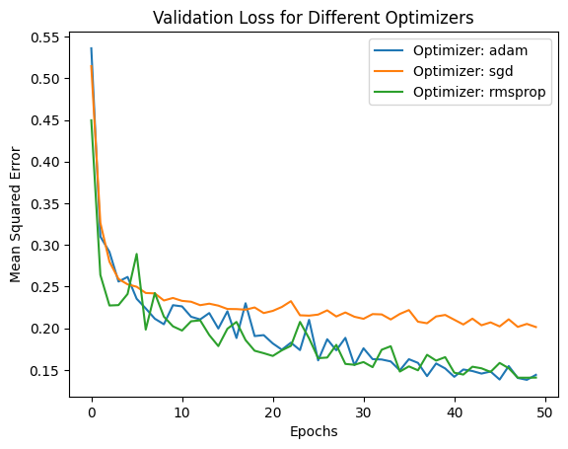
Methodology
• Optimization:
• Experimentation with various activation functions, optimizers (e.g., Adam, SGD), and batch sizes to achieve optimal performance
• Training Setup:
• Using mean squared error (MSE) as the loss function
• Model trained with a dataset split into training and validation subsets ( 80% and 20% )
Contributed by Wei Xia & ShihYu Huang

Slide 6
Results
Key Findings:
Test Mean Absolute Error (MAE): 0.155
Model Performance: The feedforward neural network outperforms the linear regression model by effectively capturing non-linear relationships in high-dimensional data
Feature Importance increase in MAE: Date: 1.0246 Net import: 0.2323 Date (representing significant historical events) is identified as the most influential factor affecting gasoline prices
Contributed by Tianchen Wang &ShihYu Huang
Notes:
First, the test Mean Absolute Error, or MAE, of our model is 0.155, demonstrating its accuracy. Comparing model performance, we found that the feedforward neural network significantly outperforms the linear regression model. This is because it effectively captures non-linear relationships in high-dimensional data, which the linear model struggles with.
Now, turning to feature importance: the increase in MAE when key features are excluded highlights their impact. Specifically, the 'Date' feature shows an MAE increase of 1.0246, followed by 'Net Import' at 0.2323. This indicates that historical events represented by the 'Date' feature are the most influential factors affecting gasoline prices.
Overall, these findings emphasize the importance of advanced modeling techniques and feature selection in predictive analysis

Slide 7
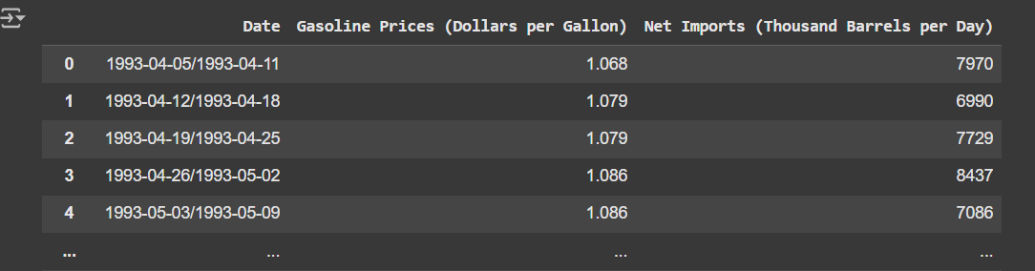
Challenges and Solutions
• Challenges:
- Data preprocessing complexities (weather data)
- Can not explain the result easily
- Model selection issues
• Solutions:
- Improved feature engineering
- Hyperparameter tuning
Contributed by Wei Xia & ShihYu Huang
Notes:
One major challenge was the complexity of data preprocessing, especially with weather data, which required significant effort to clean and structure. Additionally, the results of the model were not easy to interpret, making it difficult to provide clear explanations. We also faced issues with model selection, as choosing the right model required balancing performance and interpretability.
To address these challenges, we implemented improved feature engineering techniques to better capture key data patterns. We also performed extensive hyperparameter tuning to optimize model performance and ensure it aligned with our objectives.
These solutions helped us overcome the obstacles and achieve more reliable and actionable results

Slide 8
Conclusion and Future Work
• Summary:
- Accurate predictions help citizens and policymakers
- The results showed that net import had a smaller impact than expected, while the date proved to be the key factor affecting oil prices
• Future Steps:
- Incorporating more features.(e.g., weather, car sales)
- Exploring alternative models (e.g., RNN, transformers)
Contributed by Wei Xia & Tang-Shuo Kao
Notes:
"In summary, our model provides accurate predictions, which can help both citizens and policymakers make informed decisions. While our results showed that net import had a smaller impact than expected, the date emerged as the most significant factor influencing oil prices.
However, it’s important to note that the date is ultimately just a number. To truly understand its impact, we need to uncover the underlying reasons. For example, certain dates might reflect seasonal trends, such as higher oil demand in winter when more people drive. To address this, we need to incorporate additional features, such as weather conditions or car sales, to provide a more complete picture.
Looking ahead, we also plan to explore alternative models, like recurrent neural networks or transformers, to capture more complex patterns in the data. These steps will help us identify the true drivers of oil prices and improve the model's explanatory power. Thank you."

Slide 9
Acknowledgments
• Team Members:
- Tianchen Wang, Wei Xia, Shih-Yu Huang, Tang-Shuo Kao
• Program:
- Fall 2024 - IE 534 Deep Dive Project

